Slide 1
Putting It Together
Sweet Client and Server Harmony

Slide 2
Development and Production Environments

Slide 3
Architecture of a SPA (Dev)
ASP.NET Core Application (Back-end)
https://localhost:5000
Browser
Network
Vue.JS Application (Front-end)
https://localhost:3000
Notes:
Architectural drawing
Front-end (Vue) -> Back-end (ASP.NET Core) -> Other services (Database, etc)

Slide 4
Architecture of a SPA (Prod)
ASP.NET Core Application (Back-end)
Browser
Network
Compiled Vue.JS Application
Notes:
Architectural drawing
Front-end (Vue) -> Back-end (ASP.NET Core) -> Other services (Database, etc)

Slide 5
Architecture of a SPA (Prod)
ASP.NET Core Application (Back-end)
https://myApp.com
Browser
Network
Vue.JS Application (Front-end)
https://api.myApp.com
Notes:
Architectural drawing
Front-end (Vue) -> Back-end (ASP.NET Core) -> Other services (Database, etc)

Slide 6
Architecture of a SPA (Dev Proxy)
ASP.NET Core Application (Back-end)
https://localhost:5000
Browser
Network
Vue.JS Application (Front-end)
https://localhost:3000/api
https://localhost:3000
Notes:
Architectural drawing
Front-end (Vue) -> Back-end (ASP.NET Core) -> Other services (Database, etc)

Slide 7
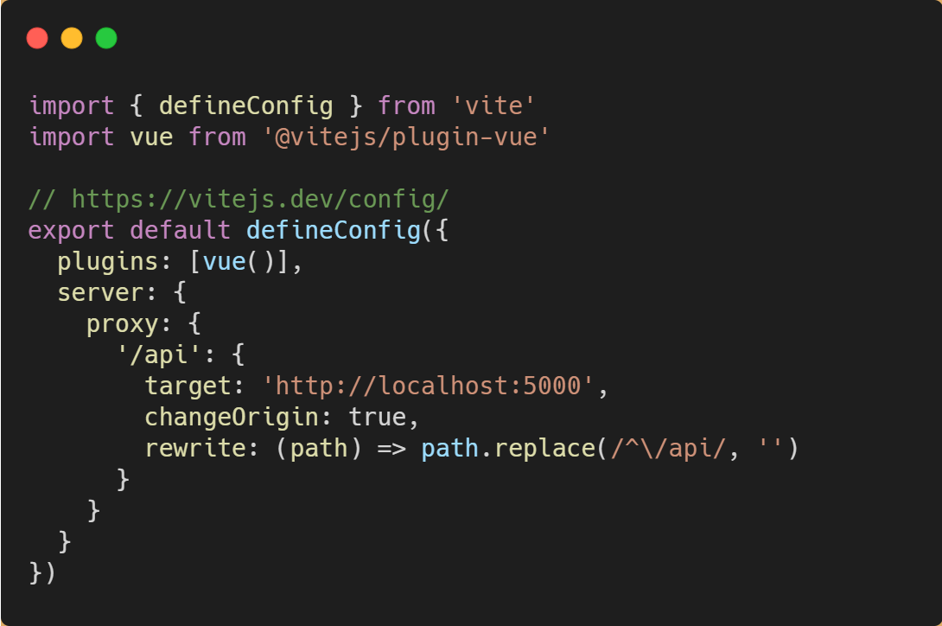
Setting up a Proxy with Vite

Slide 8
Axios

Slide 9
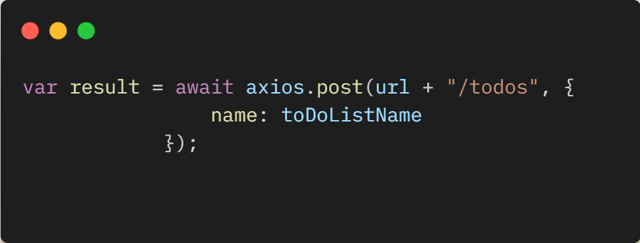
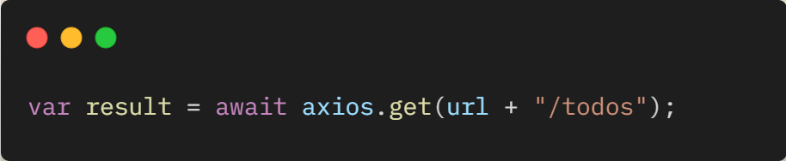
Axios
A fantastic little library for making HTTP requests to APIs or other services.
Cross-browser support
Easy to use API
Async/Await Support
https://axios-http.com

Slide 10
Demo
Axios in Action

Slide 11
Hands On Lab: Putting it Together
If you haven’t already, pull the latest GitHub repo for this workshop
Go to the “/exercises/6_Putting It Together” folder and open the README.md.
Length: 20 minutes

